Slide 1

Note: The data and information in this document is reflective of a hypothetical situation and client. This document is to be used for KPMG Virtual Internship purposes only.
Sprocket Central Pty Ltd
Data analytics approach
[Division Name] - [Engagement Manager], [Senior Consultant], [Junior Consultant]

Slide 2
Note: The data and information in this document is reflective of a hypothetical situation and client. This document is to be used for KPMG Virtual Internship purposes only.
Agenda
The Approach will be implemented in Three steps:
Data Exploration
Model Development
Interpretation

Slide 3
Note: The data and information in this document is reflective of a hypothetical situation and client. This document is to be used for KPMG Virtual Internship purposes only.
Introduction
In today's competitive market, businesses strive to effectively target their marketing efforts towards the right customers to maximize their return on investment. Understanding the characteristics and preferences of potential customers is crucial for successful marketing campaigns. This project aims to identify target customers based on demographic criteria to optimize marketing strategies and increase sales in the bicycle industry.

Slide 4
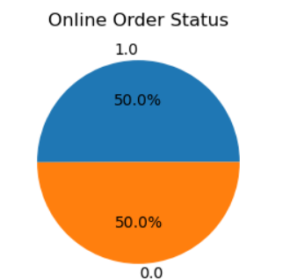
Note: The data and information in this document is reflective of a hypothetical situation and client. This document is to be used for KPMG Virtual Internship purposes only.
Data Exploration : Transactions Table
Buying cycles online and offline are having the same sale rate
Hence no importance should be given to selling bicycles online or through stores .
Place any supporting images, graphs, data or extra text here.

Slide 5
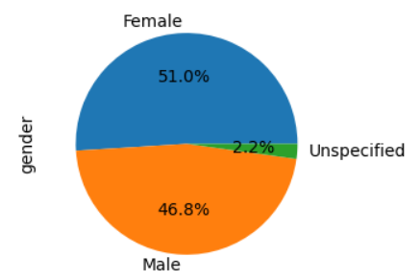
Note: The data and information in this document is reflective of a hypothetical situation and client. This document is to be used for KPMG Virtual Internship purposes only.
Data Exploration : Customerdemographic table
Bicycle sales are more associated with females but only to a marginal difference
Since the difference is marginal it can be neglected
Place any supporting images, graphs, data or extra text here.

Slide 6
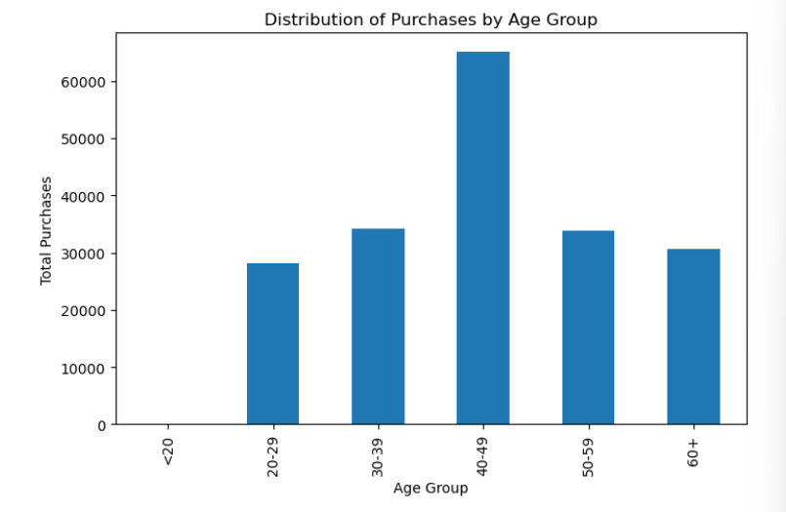
Note: The data and information in this document is reflective of a hypothetical situation and client. This document is to be used for KPMG Virtual Internship purposes only.
Data Exploration : Customerdemographic table
People aged between 40 -49 are having highest sales and those aged less than 20 is having least sale
By concentrating more on those aged from 40 – 49 we can target more sales
Place any supporting images, graphs, data or extra text here.

Slide 7
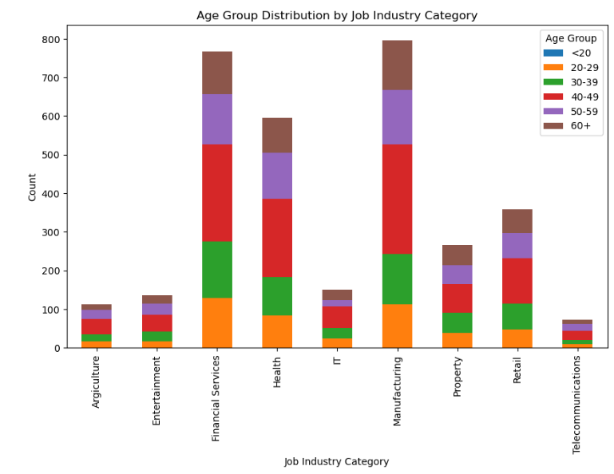
Note: The data and information in this document is reflective of a hypothetical situation and client. This document is to be used for KPMG Virtual Internship purposes only.
Data Exploration : Customerdemographic table
Those working in financial services ,manufacturing and health industry contribute more towards the sale and the least is from Telecommunication
By concentrating more on those aged from 40 – 49 and those working in financialservices,manufacturing,and health we can target more sale .
Place any supporting images, graphs, data or extra text here.

Slide 8
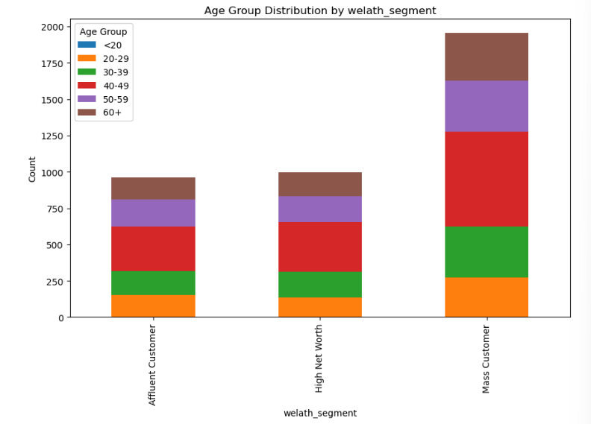
Note: The data and information in this document is reflective of a hypothetical situation and client. This document is to be used for KPMG Virtual Internship purposes only.
Data Exploration : Customerdemographic table
People from mass customer wealth_segment contribute more to the sale and highnet_worth and affluent customer category have the same contribution
By targeting mass customer category we can aim for more sales .
Place any supporting images, graphs, data or extra text here.

Slide 9
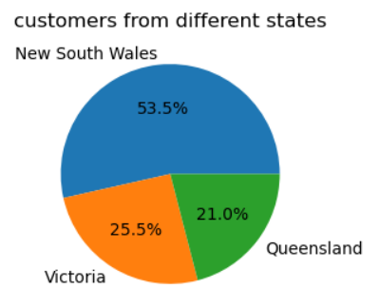
Note: The data and information in this document is reflective of a hypothetical situation and client. This document is to be used for KPMG Virtual Internship purposes only.
Data Exploration : CustomeeAddresses table
More than 50% of the sales were from new south wales and the least was from queensland
By concentrating more on those aged from 40 – 49 and those working in financialservices,manufacturing,and health we can target more sale .
Place any supporting images, graphs, data or extra text here.

Slide 10
Note: The data and information in this document is reflective of a hypothetical situation and client. This document is to be used for KPMG Virtual Internship purposes only.
Model Development –Targeting High Value Customers
The following are the conditions that should be met in order to Target High Value Customers
Aged between 40-49
People working in financial services, manufacturing and health industry
People belonging to mass customers in wealth segment category
Those people living in New South wales

Slide 11
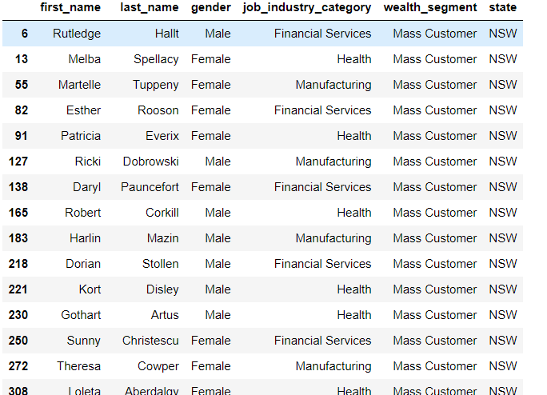
Note: The data and information in this document is reflective of a hypothetical situation and client. This document is to be used for KPMG Virtual Internship purposes only.
Interpretation
These are the target customers to focus on based on above findings
Place any information about this point here.

Slide 12
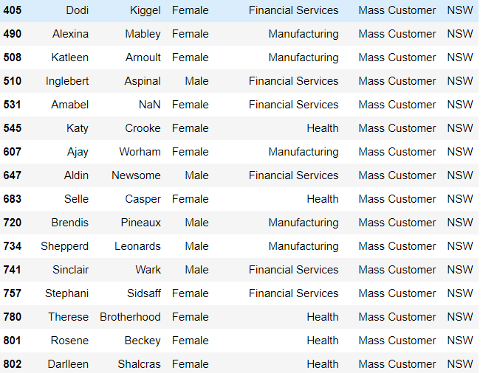
Note: The data and information in this document is reflective of a hypothetical situation and client. This document is to be used for KPMG Virtual Internship purposes only.
Interpretation
These are the target customers to focus on based on above findings
Place any information about this point here.

Slide 13
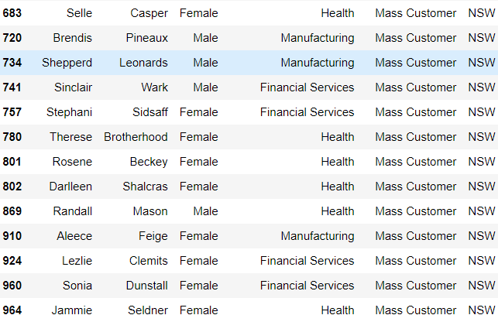
Note: The data and information in this document is reflective of a hypothetical situation and client. This document is to be used for KPMG Virtual Internship purposes only.
Interpretation
These are the target customers to focus on based on above findings
Place any information about this point here.

Slide 14
Note: The data and information in this document is reflective of a hypothetical situation and client. This document is to be used for KPMG Virtual Internship purposes only.
THANK YOU

